Slide 1
Irradiance Meter
Alex Polyanskiy
Montana State University
Bozeman, MT

Slide 2
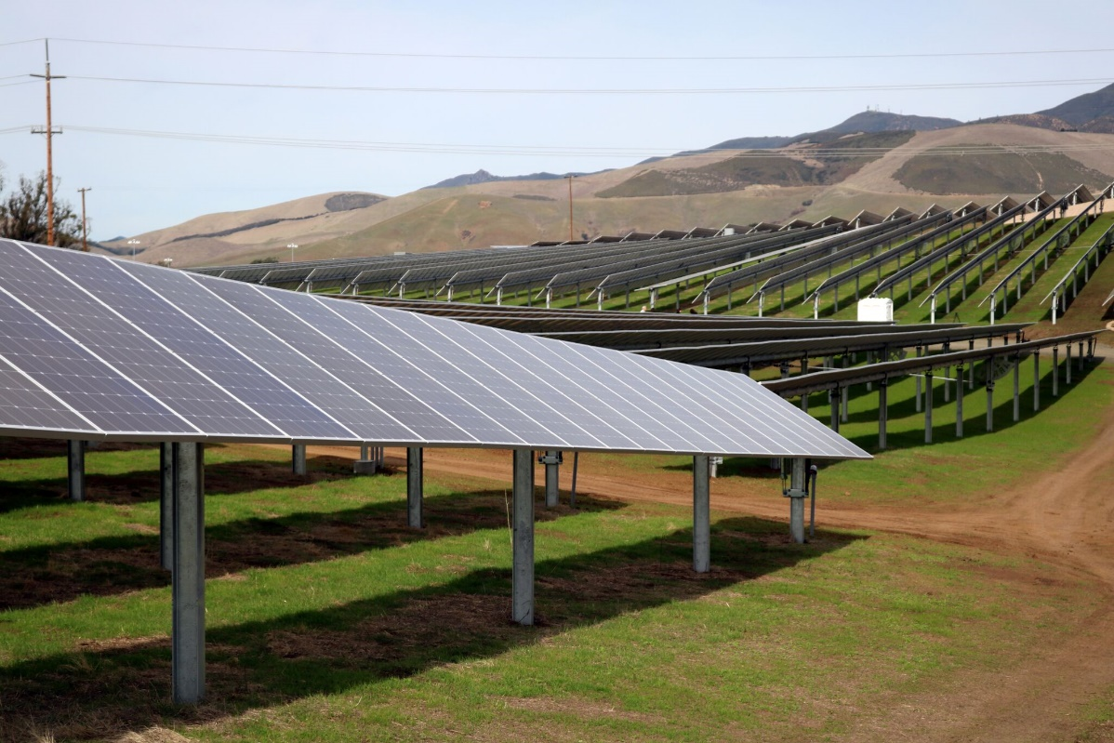
Project Overview
Design a prototype irradiance meter
Research
Select irradiance sensor and design circuit
Incorporate an inclinometer
Incorporate temperature sensor for ambient temperature and solar panel temperature
Build prototype
Test prototype

Slide 3
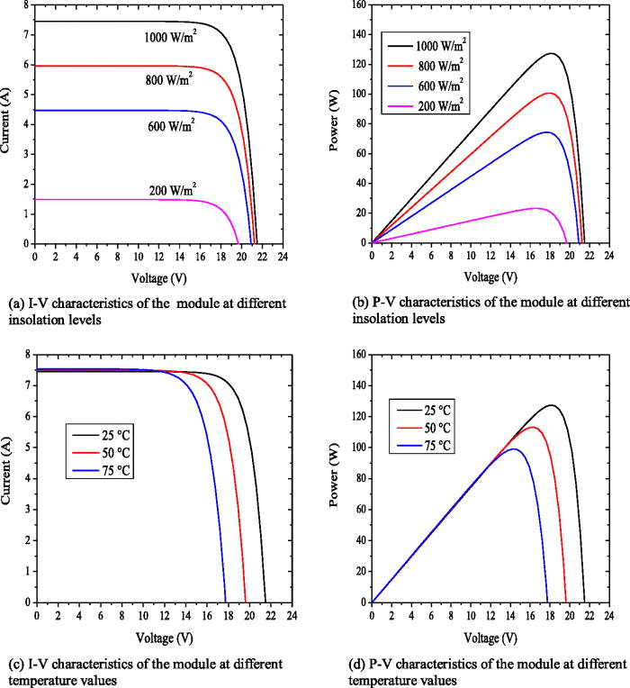
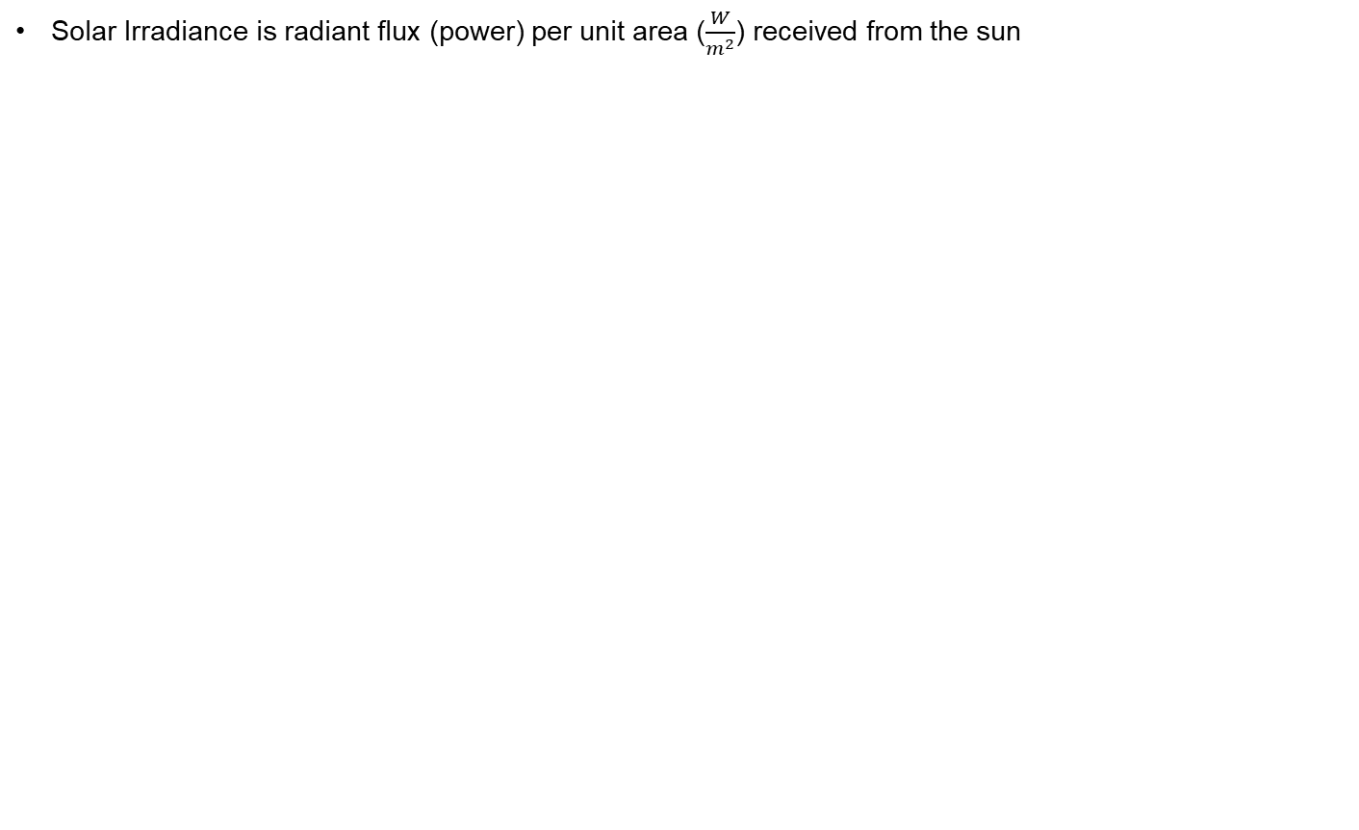
Solar Irradiance
Solar Irradiance is radiant flux (power) per unit area ($\frac{W}{m^{2}}$) received from the sun

Slide 4
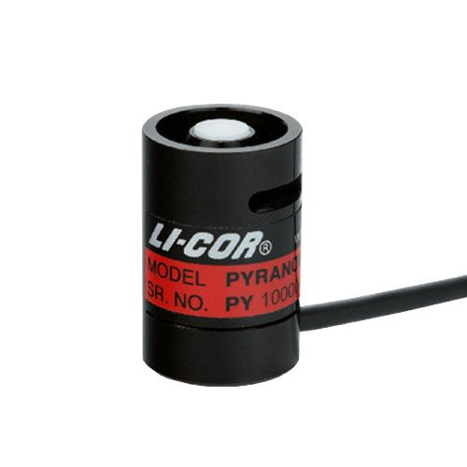
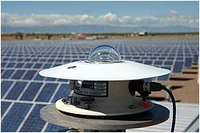
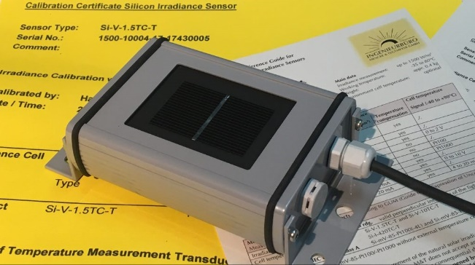
Measuring Solar Irradiance
A pyranometer measure global irradiance (direct + diffused)
Irradiance is the integral of the spectrum over all wavelengths
Thermopile | Photodiode | Reference Cell
Flat Spectral Response Highest Accuracy Most Expensive Not used in handheld meters | Spectrally Selective, not what a panel sees Least Accurate Least Expensive Requires angle correction | Closely matches PV panel spectral response Accurate to PV Panels Cost depends on the Cell Calibration Sees what a solar panel sees
4

Slide 5
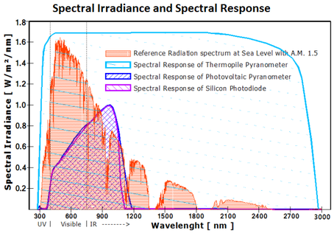
Spectral Sensitivity
5

Slide 6
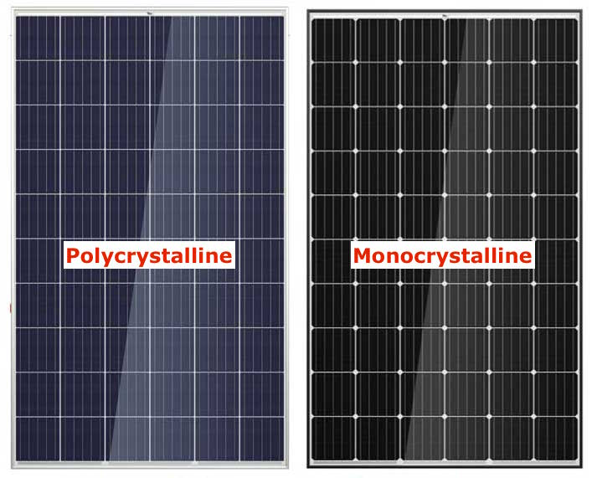
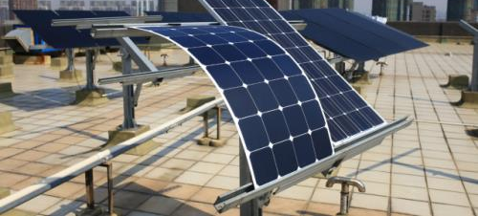
Types of panels available
Monocrystalline (Mono-Si)
20% or greater
Expensive
Space- efficient
Polycrystalline (P-Si)
around 15%
Process to make is cheaper and simpler
Amorphous
7-10%
Best if space is not an issue
Degrade faster
Cadmium Telluride (CdTe)
14-18%
Disposal and recycling is costly and dangerous
Copper Indium Gallium Selenide (CIGS)
up to 22.4%
Many manufacture have gone bankrupt
Gallium Arsenide (GaAs)
up to 28.9%
Most expensive
Used on spacecrafts
Thin-Film
6

Slide 7
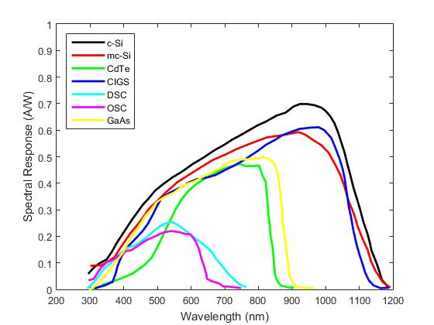
Spectral responsivity of different solar cells
Irradiance is the integral of the spectrum over all wavelengths
7

Slide 8

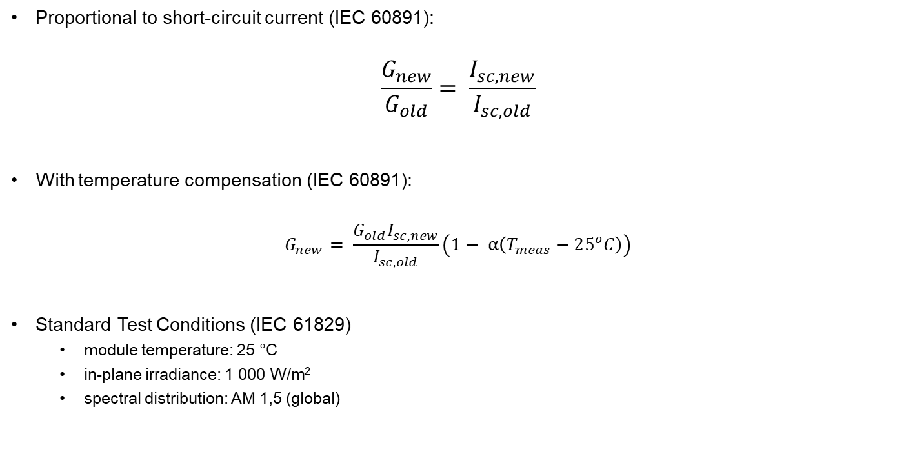
Calculating Irradiance
Proportional to short-circuit current (IEC 60891):
$$\frac{G_{new}}{G_{old}}= \frac{I_{sc, new}}{I_{sc, old}}$$
With temperature compensation (IEC 60891):
$$G_{new}= \frac{G_{old}I_{sc, new}}{I_{sc, old}}\left(1− α\left(T_{meas}−25^{o}C\right)\right)$$
Standard Test Conditions (IEC 61829)
module temperature: 25 °C
in-plane irradiance: 1 000 W/m²
spectral distribution: AM 1,5 (global)
8

Slide 9
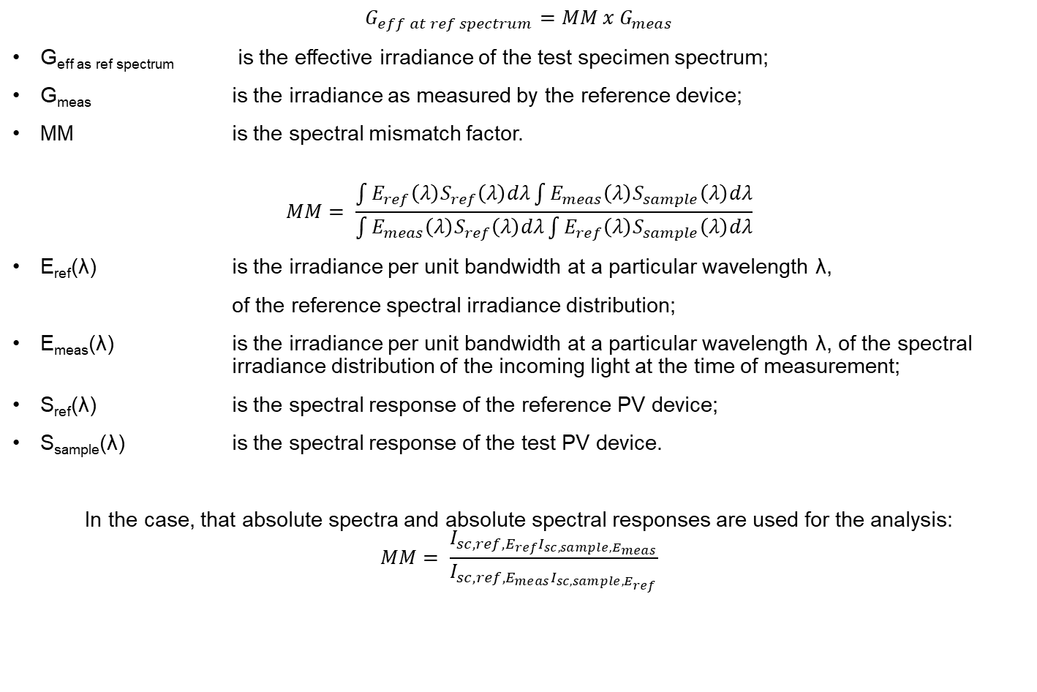
Mismatch Factor (IEC 60904-7)
$$G_{eff at ref spectrum}=MM x G_{meas}$$
G_{eff as ref spectrum} is the effective irradiance of the test specimen spectrum;
G_{meas} is the irradiance as measured by the reference device;
MM is the spectral mismatch factor.
$$MM= \frac{\int{E_{ref}\left(λ\right)S_{ref}\left(λ\right)dλ\int{E_{meas}\left(λ\right)S_{sample}\left(λ\right)dλ}}}{\int{E_{meas}\left(λ\right)S_{ref}\left(λ\right)dλ}\int{E_{ref}\left(λ\right)S_{sample}\left(λ\right)dλ}}$$
E_{ref}(λ) is the irradiance per unit bandwidth at a particular wavelength λ,
of the reference spectral irradiance distribution;
E_{meas}(λ) is the irradiance per unit bandwidth at a particular wavelength λ, of the spectral irradiance distribution of the incoming light at the time of measurement;
S­­_{ref}(λ) is the spectral response of the reference PV device;
S_{sample}(λ) is the spectral response of the test PV device.
In the case, that absolute spectra and absolute spectral responses are used for the analysis:
$$MM= \frac{I_{sc,ref,E_{ref}I_{sc,sample,E_{meas}}}}{I_{sc,ref,E_{meas}I_{sc,sample,E_{ref}}}}$$
9

Slide 10
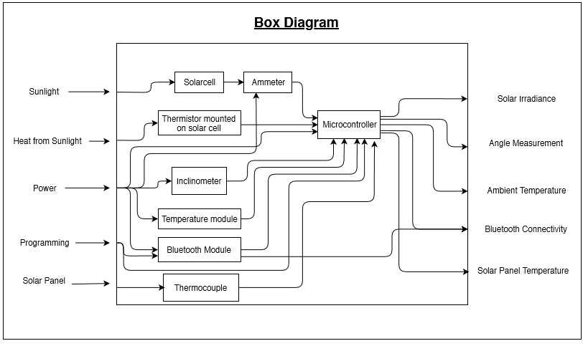
Functional Overview
10

Slide 11
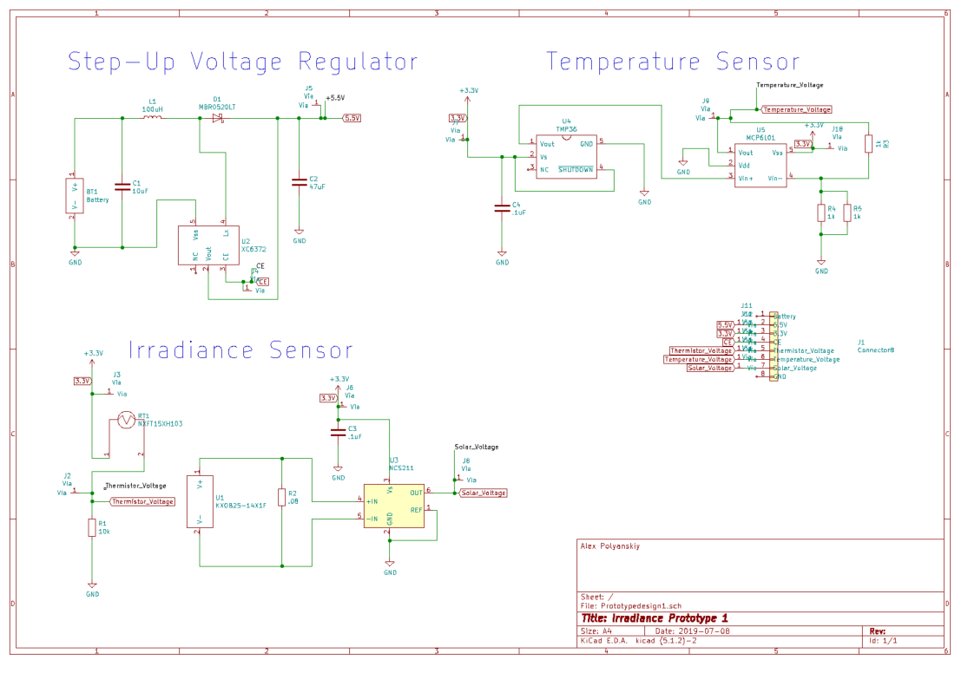
First Design
11

Slide 12

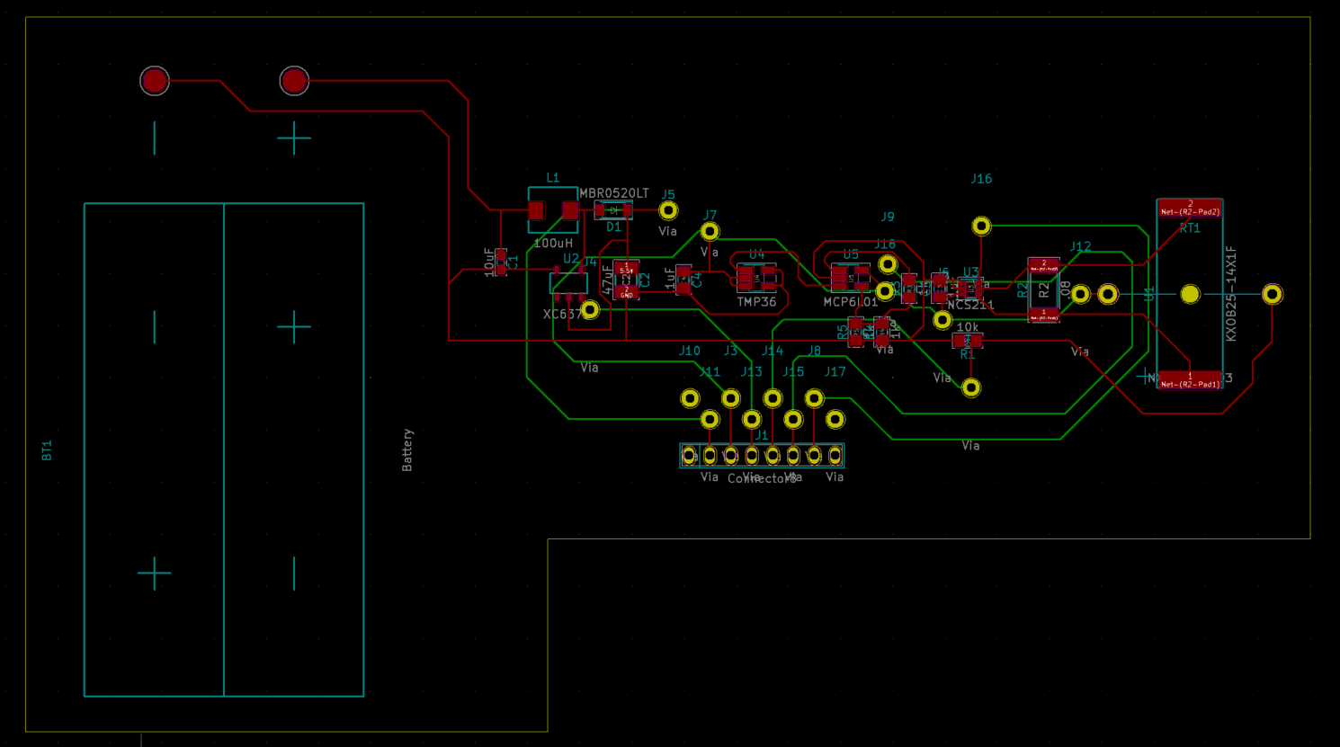

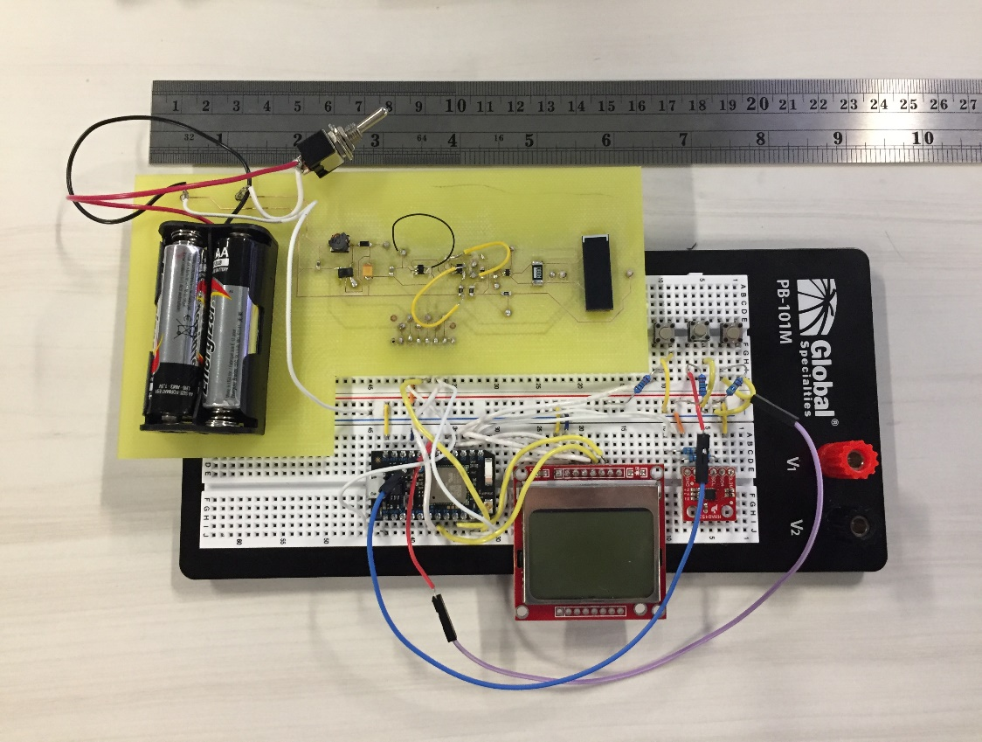
First Design
Solar Cell
Temperature Sensor
Microcontroller
LCD
Inclinometer
12

Slide 13
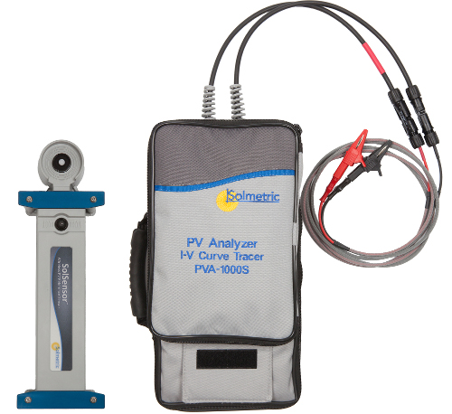
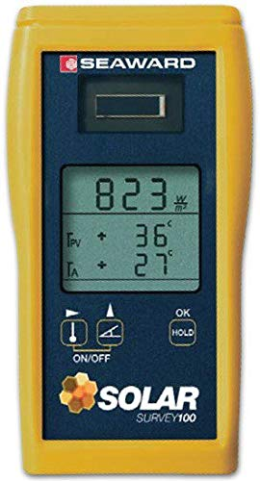
Devices on the Market
Solmetric SolSensor
(photodiode)
Seaward Solar Survey200R
(reference cell)
13

Slide 14
Results
14

Slide 15
Measurement Comparison (average of 6.8 W/m²)
15

Slide 16
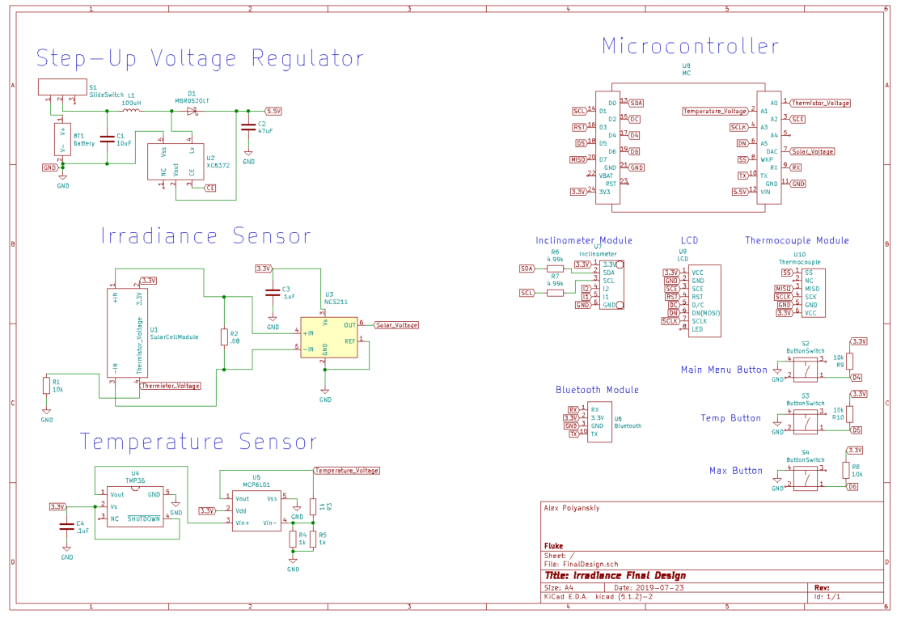
Second Design
16

Slide 17
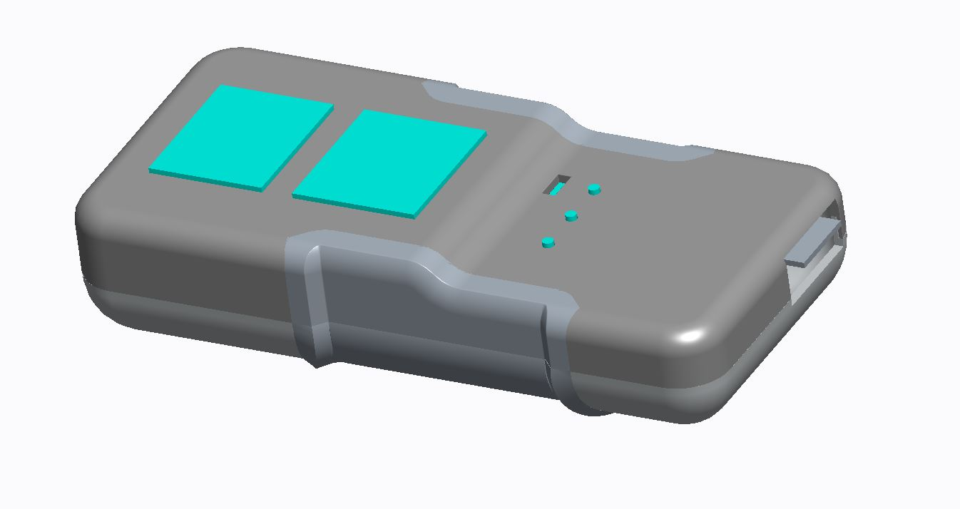
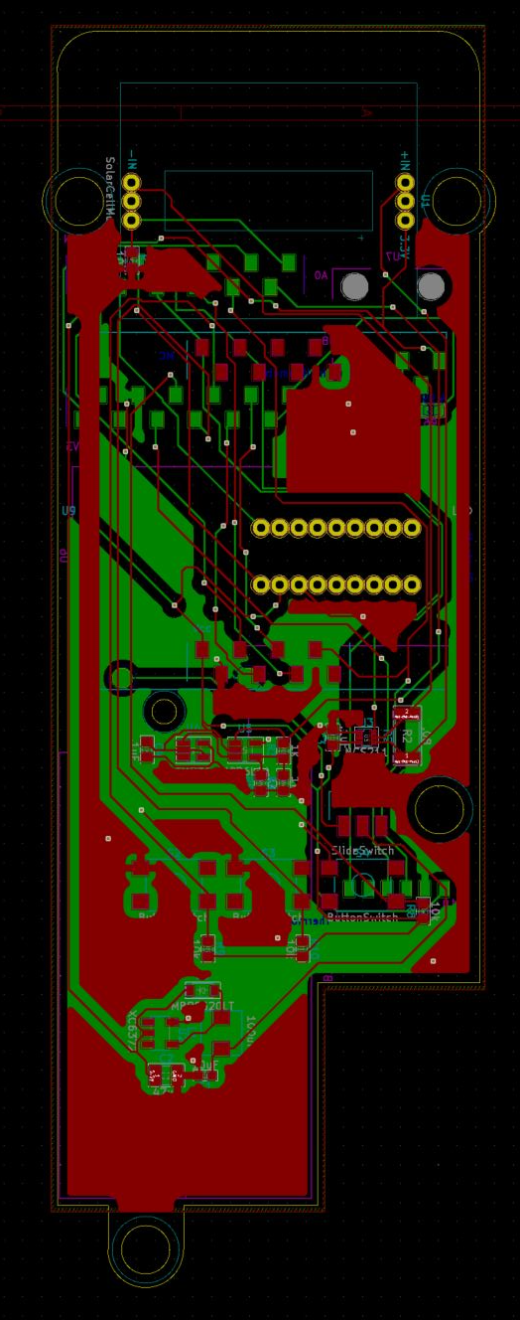
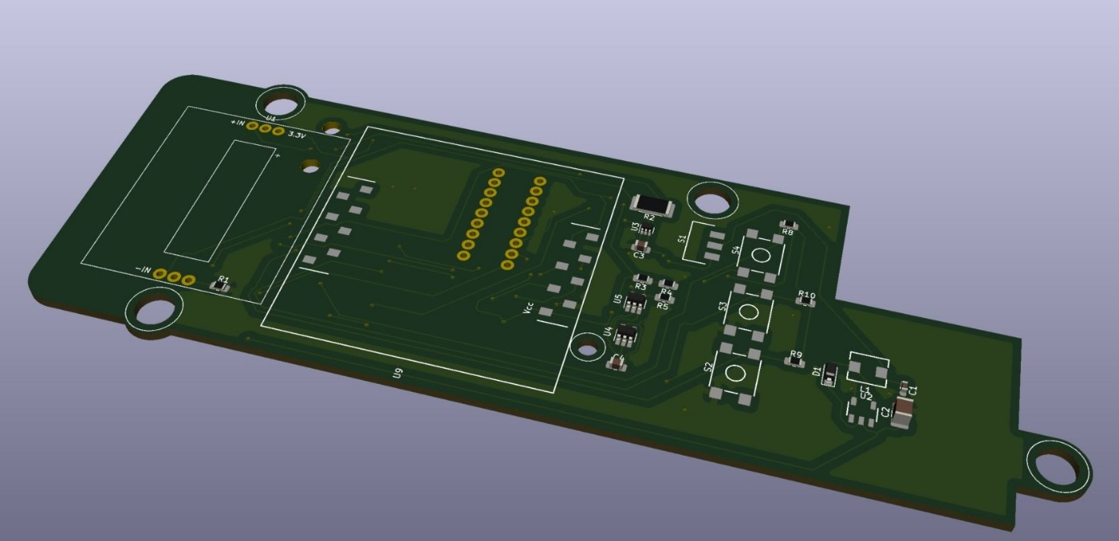
Second Design
LDC
Buttons
Solar Cell
Bluetooth
Thermocouple
Mounting Holes
17

Slide 18
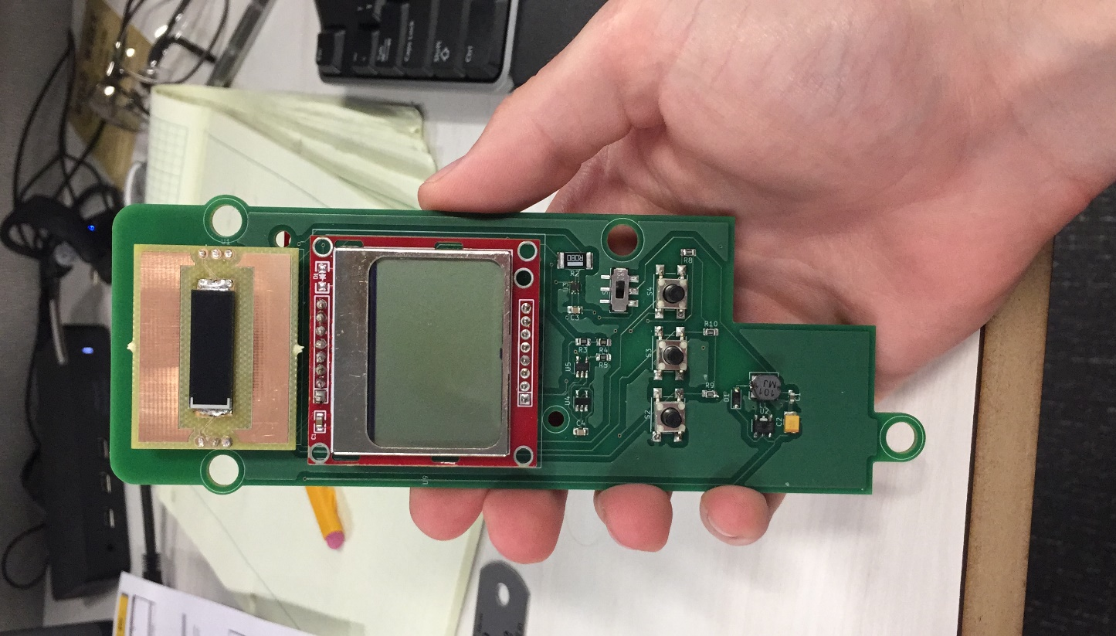
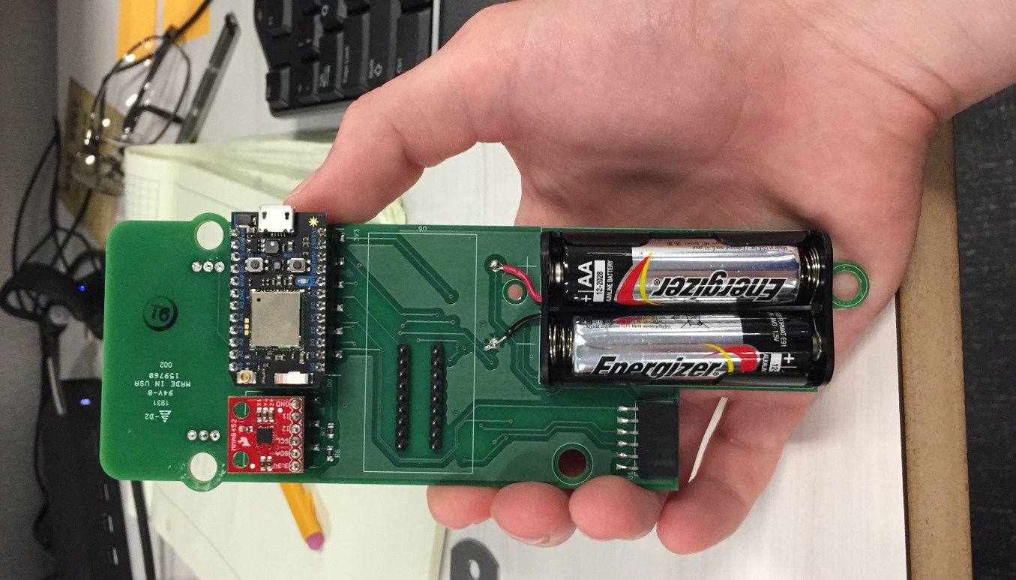
Second Design
Front View
Back View
18

Slide 19

Ways to improve design
Add a lowpass filter
4-wire contact for shunt resistor
Test Cell at standard conditions
Compare to a secondary standard
Use electrical components with lower error
19

Slide 20
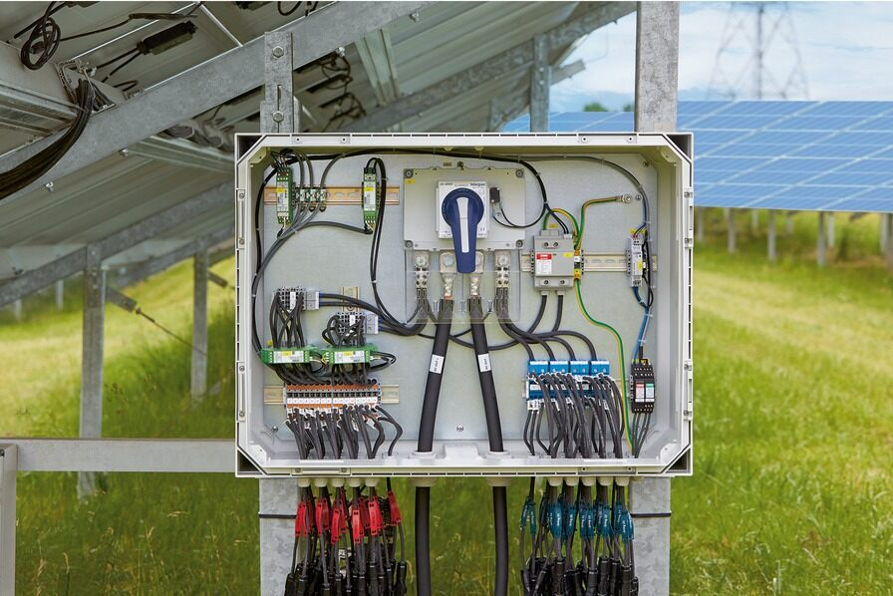
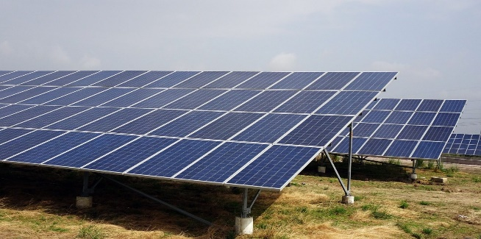
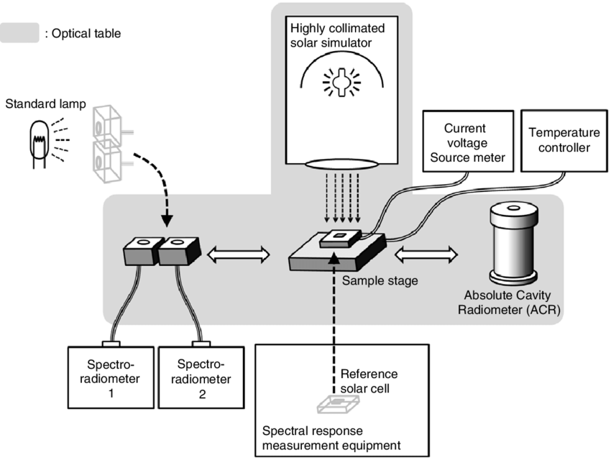
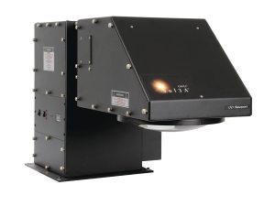
Additional Tasks
DC Combiner Box Research
Solar Panel Research
Calibration Techniques
Solar Simulator Research
20

Slide 21
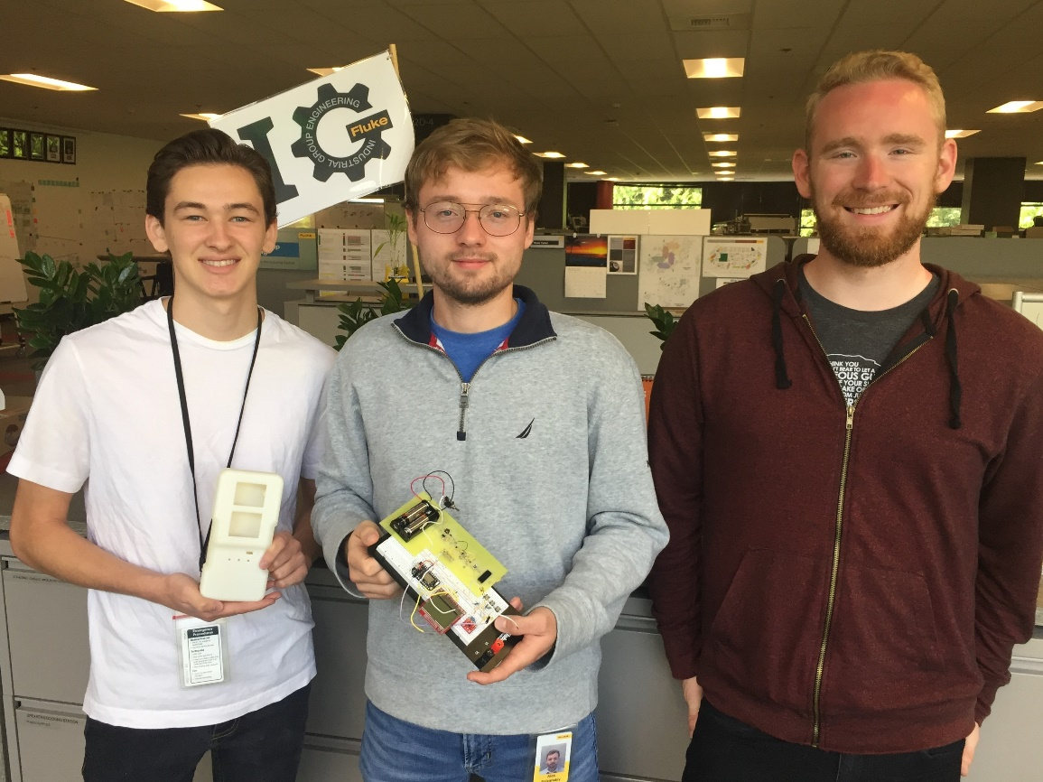
Internship Take-aways
Design Review, what to consider, how to select parts
PCB Design
Error Analysis
Working with Computer Engineering and Mechanical Engineering
Corporate Environment
Meetings
21

